Slide 1
Leveraging Background Services and Agents in Windows Phone 7 (Mango)
Jon Galloway
Microsoft
http://weblogs.asp.net/jgalloway
Notes:
http://msdn.microsoft.com/en-us/library/hh202942%28v=VS.92%29.aspx
http://msdn.microsoft.com/en-us/library/ff637516(v=VS.92).aspx
http://jesseliberty.com/2011/10/05/background-agents/#more-5060
http://msdn.microsoft.com/en-us/library/hh394039(v=VS.92).aspx
Background Transfer - http://msdn.microsoft.com/en-us/library/hh202955(v=VS.92).aspx

Slide 2
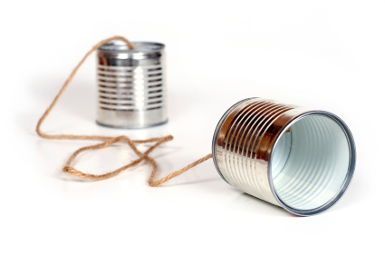

Slide 3


Slide 4


Slide 5


Slide 6
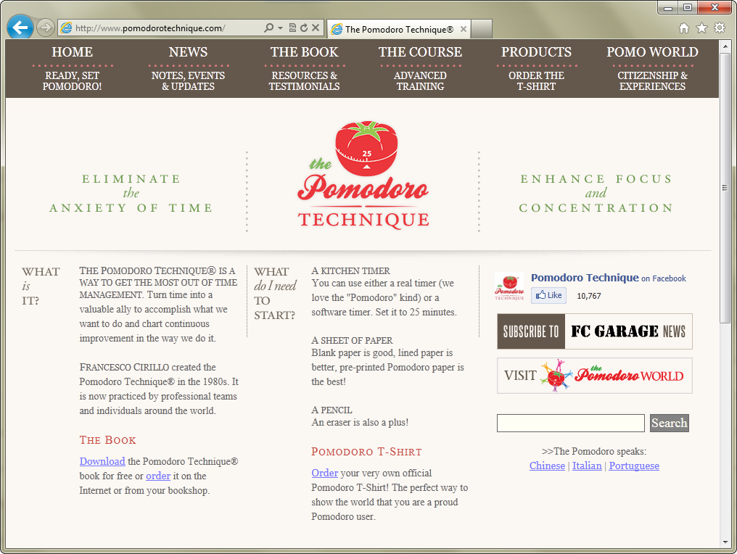

Slide 7


Slide 8
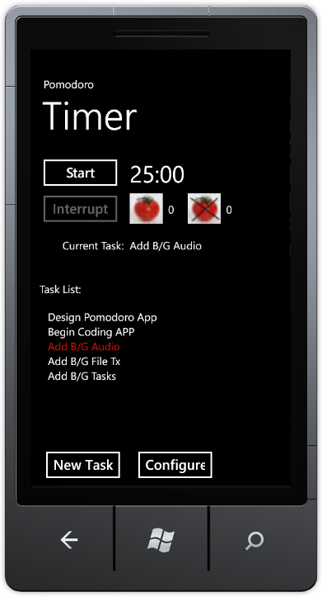

Slide 9
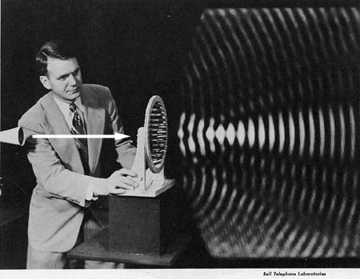
Background Audio

Slide 10
Background Audio
Continues to play when you navigate away
Uses Zune playlist, Universal Volume Control
Internet URI or Isolated Storage
Implementation
BackgroundAudioPlayer
AudioPlayerAgent

Slide 11
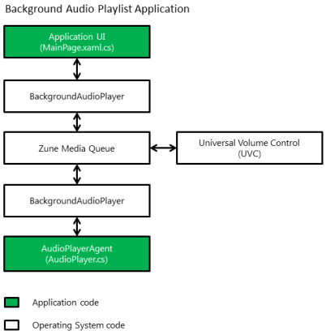

Slide 12
Demo
Audio

Slide 13
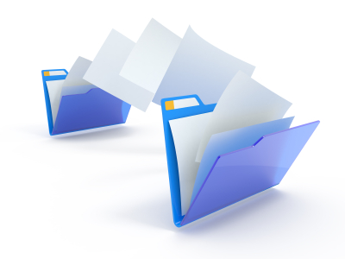
Background File Transfer

Slide 14
Background File Transfer - Size
Maximum upload file size | 5 MB
Maximum download size over cellular connection | 20 MB – If a file exceeds this limit, the TransferPreferences property for the transfer is automatically changed to AllowBattery, which has the effect of requiring Wi-Fi for the transfer.
Maximum download size over Wi-Fi without external power | 100 MB – Files larger than 100 MB must set the TransferPreferences property of the transfer to None or the transfer will fail. If you do not know the size of a transfer and it is possible that it could exceed this limit, you should set the value to None.

Slide 15
Background File Transfer - Limits
Maximum outstanding requests in the queue per application (this includes active and pending requests). | 5 – Transfers are not removed from the queue automatically when they complete.
Maximum concurrent transfers across all applications on the device | 2
Maximum queued transfers across all applications on the device | 500

Slide 16
Demo
Background File Transfer
Notes:
http://msdn.microsoft.com/en-us/library/hh202955(v=VS.92).aspx

Slide 17
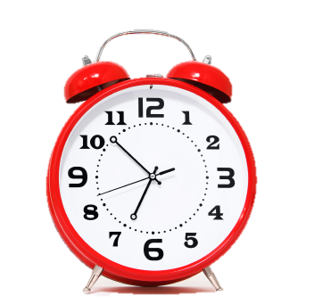
Alarms & Reminders
Demo
Notes:
Alarms and Reminders (Demo)

Slide 18
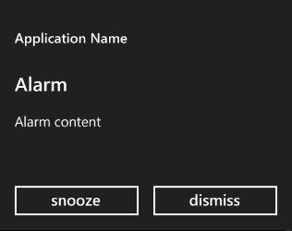
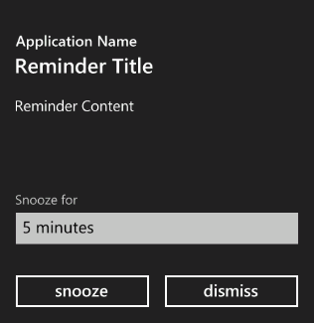
Alarms & Reminders
Demo
Notes:
Alarms and Reminders (Demo)

Slide 19
Alarm
Displays the Application Name
Always shows Alarm as the UI title
Displays text provided by the application
Application can set alarm sound
The sound begins quietly, gets louder
Tapping Alarm takes user to initial page of app (same as first launch)
Notes:
Alarms and Reminders (Demo)

Slide 20
Reminder
Displays a title that is provided by the app
Uses the default notification sound
When the user taps the Reminder, the application can provide a navigation URI and query string parameters to which the application will navigate when it is launched
Notes:
Alarms and Reminders (Demo)

Slide 21
Alarms & Reminders
Demo
Notes:
Alarms and Reminders (Demo)

Slide 22
Demo
Reminders and Alarms
Notes:
http://msdn.microsoft.com/en-us/library/hh202955(v=VS.92).aspx

Slide 23
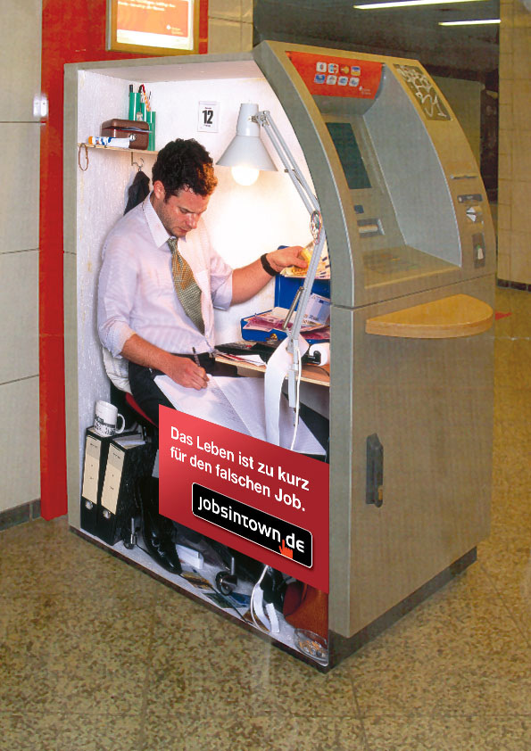
Alarms & Reminders
Demo
Background
Agents

Slide 24
Periodic agents run for a short time on a regular recurring interval.
Examples:
Uploading the device’s location
Small amounts of data synchronization

Slide 25
Periodic Agent Constraints
Scheduled interval: 30 minutes
Typically run every 30 minutes, may drift by up to 10 minutes.
Scheduled duration: 25 seconds
Periodic agents typically run for 25 seconds, may be terminated earlier.
Battery Saver mode can prevent execution
Per-device periodic agent limit: 6
User may be warned earlier

Slide 26
Resource Intensive agents run for a relatively long period of time when the phone meets a set of requirements relating to processor activity, power source, and network connection.
Example:
Synchronizing large amounts of data when phone’s not being used.

Slide 27
Resource Intensive Agent Constraints
Duration: 10 minutes
External power required
Non-cellular connection required
Minimum battery power: 90%
Device screen lock required
No active phone call
Cannot change network to cellular

Slide 28
Resource Intensive Agent
Might never run on some devices.
Example: User doesn’t have wi-fi access

Slide 29
But that’s not all!
Additional limits for both:
Unsupported API’s
Memory usage cap: 6MB
Reschedule required: 2 weeks
Unscheduled after 2 consecutive crashes

Slide 30
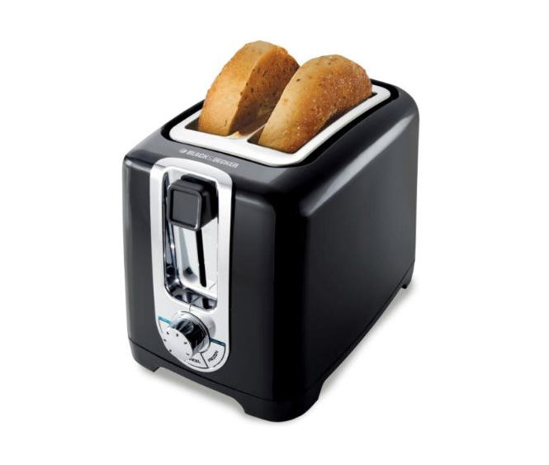
Deep Linking From Toast
Demo
Notes:
Deep linking from toast notifications (Demo)

Slide 31
ShellToast toast = new ShellToast();
toast.Title = "Background Agent Sample"; toast.Content = toastMessage;
toast.Show();

Slide 32
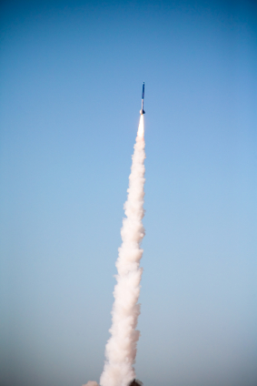
Launch for Testing

Slide 33
Demo
Background Agents

Slide 34
ShellToast toast = new ShellToast();
toast.Title = "Background Agent Sample";
toast.Content = toastMessage;
toast.Show();
#if DEBUG_AGENT
ScheduledActionService.LaunchForTest(
task.Name, TimeSpan.FromSeconds(60));
#endif

Slide 35
Recap
Background Audio
Background File Transfer
Scheduled Notifications
Reminders
Alarms
Scheduled Task
Periodic
Resource Intensive

Slide 36
Recap
Background Audio
Background File Transfer
Scheduled Notifications
Reminders
Alarms
Scheduled Tasks
Periodic
Resource Intensive

Slide 37
Thank you! http://weblogs.asp.net/jgalloway @jgalloway
Jon Galloway | Microsoft

Slide 38
Your Feedback is Important
Please fill out a session evaluation form drop it off at the conference registration desk.
Thank you!

